Slide 1
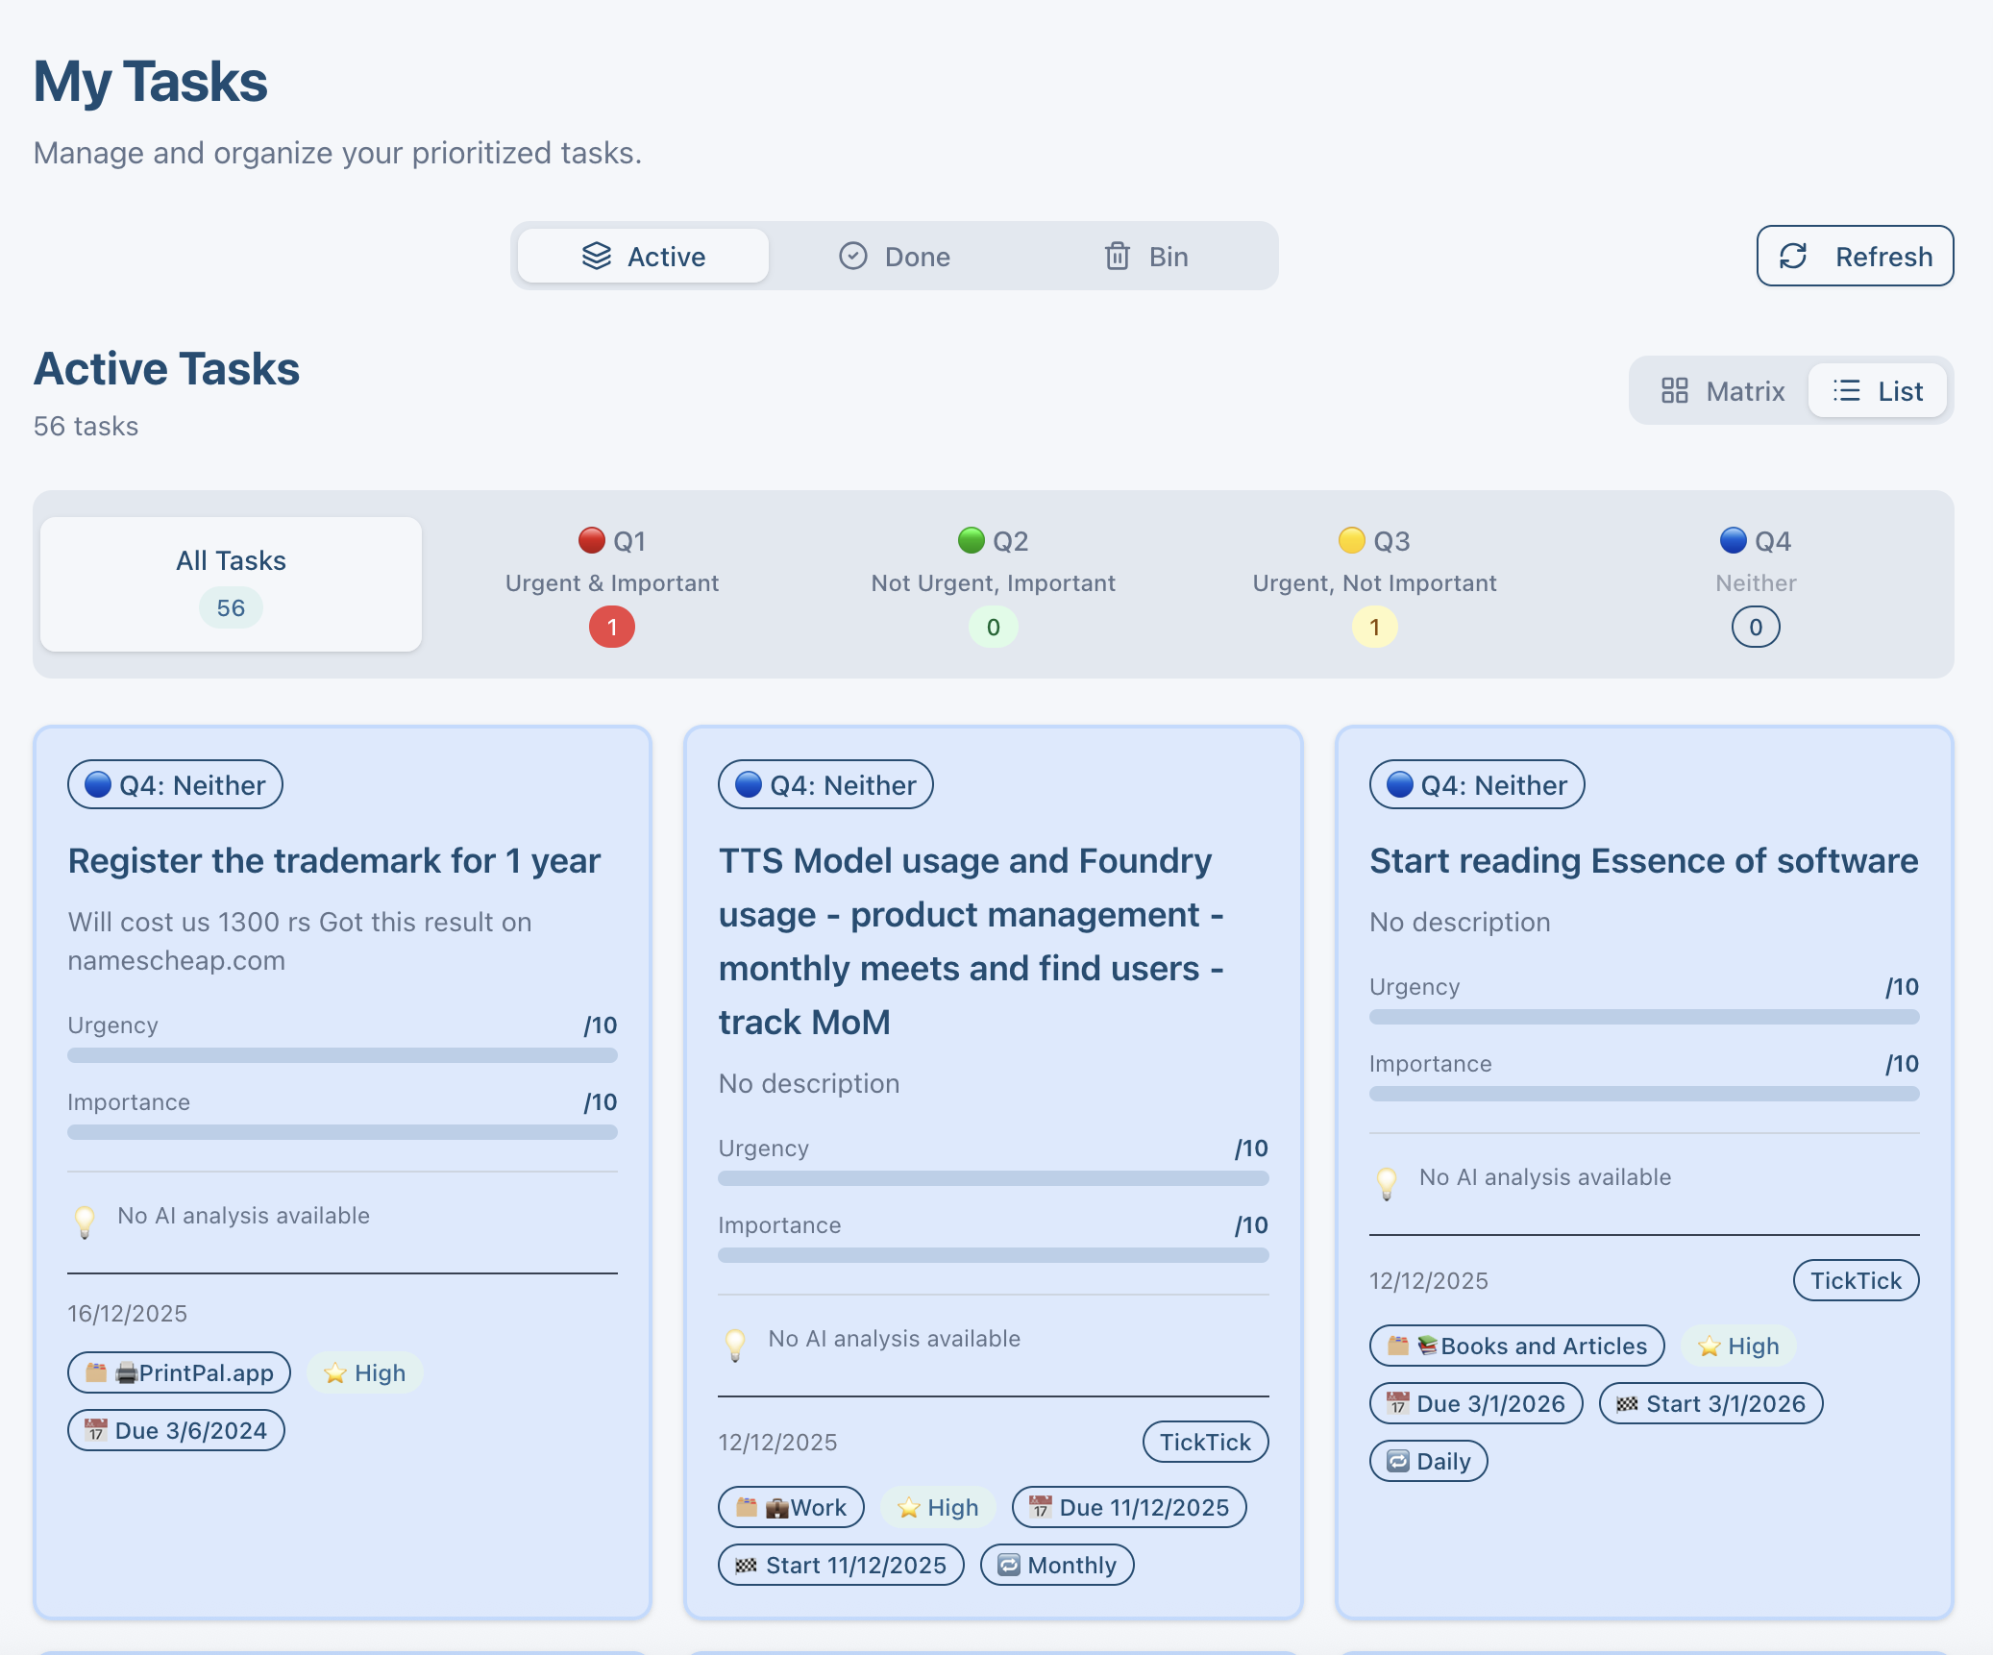
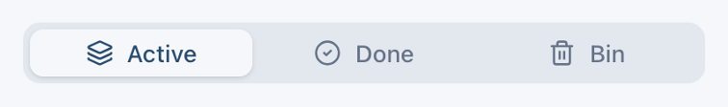

Slide 2
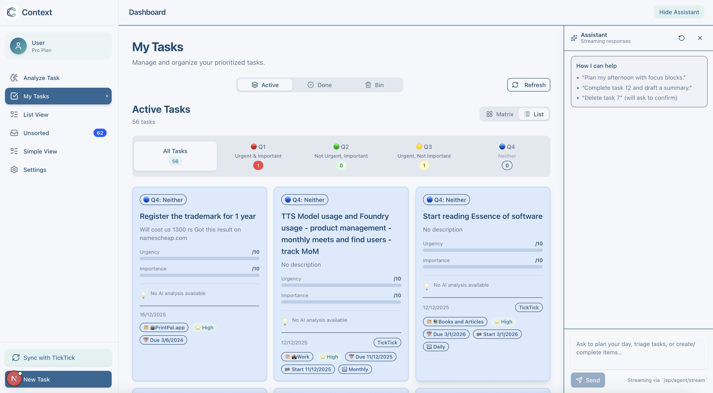
No need of refresh
This goes away
No need to mention qty here
This can be a badge on “My Tasks”
Bin moves here

Slide 3
NEW DESIGN IDEA
Bin moves here

Slide 4
Feat: Organize "My Tasks" page to be better.
Details: Active, Done and Bin show tasks, but Active only shows ones which have been organized into the Eisenhower matrix. There is a disconnect between the older part of the application where we had the Urgency and Importance being generated from LLMs, and the new part of the app, where all data is fetched from Ticktick and updated that way.
I think that there needs to be a fundamental re-think of how "My Tasks" should work:\
1. I think the Eisenhower matrix and list should the only tabs\
1.1 Maybe the search and filter functionality of the "list view" should show up here!
1.2 I talked about a lot here - we may need to break this down into smaller chunks, write out the full plan and then solve it piece by piece - but it should be driven by you
2. There should be two ways to view tasks -
2.1 a vertical card view - this should allow users to check off items, use the same animation to strike off and move to done and the information shown should look more like the items in the horizontal view - but show more useful details
2.2 a horizontal card view - use the same horizontal card view in "List view"
3. When the detail card is open, we should be able to see all details of that card - not have to scroll, so make wider and we can space information better. We need to have an "enhance card" option that doesn't specifically mention "AI" - in fact the old AI section can go. The new section should call the new API endpoints - not the older ones.
3.1. The description should show MD information directly - and I shouldn't need to hit view as MD. As we type out markdown it should get formatted...
3.2. Maybe we should tab out the date and reminder sections - Please propose a view that we can build for this popup based on the information mentioned above.
3.3 Current popup is also slightly broken - the icons and headers dont line up, there are 2 cross buttons, the check off is not clear
3.4 When we enhance with AI - it should propose time, reminder, project (if none, should suggest creating one),

Slide 5
My Tasks Redesign Plan: Replace Active/Done/Bin tabs with Matrix and List tabs; move count badge to the My Tasks nav item; keep All/Done/Bin filters within the page header (non-tab). Consolidate search/filter from current List view into this page (status, quadrant, project, tags, date, text search); ensure filters persist across Matrix/List toggles. Add view toggle between vertical cards (new default) and horizontal cards (reuse existing List card style) for both Matrix and List modes. Detail modal: two-column layout with always-on markdown rendering while typing; left = core fields (title, status checkbox, quadrant, project, priority, tags), right = description with live MD + metadata; separate inline sections for dates/reminders; fix header icons (single close, clear completion control, aligned icons). Replace old AI section with an "Enhance" action calling a new endpoint (proposal below) to suggest time, reminder, and project (create suggestion if missing) and apply edits after confirmation. Proposed enhance endpoint contract: POST /api/tasks/{id}/enhance → body {enhance_description: boolean, enhance_dates: boolean, enhance_project: boolean}; response {suggested_description?, suggested_due?, suggested_reminder?, suggested_project?, suggested_tags?, rationale}; uses TickTick-backed data/LLM pipeline (no legacy AI). Update frontend data flow to use the new endpoint; preserve existing SSE/chat integrations; ensure markdown is rendered client-side without extra clicks. QA: cross-browser visual check, verify Matrix/List filters, card toggle behavior, modal alignment, enhance flow, and regression on task completion animations. ------------------------------------ Of which some work is done, but it needsa lot of refinement. Here's my thoughts: 1. We can put the header in the top - where it says "Dashboard" right now 2. Bin should go into the left panel - and Done items can show up at the bottom and we can add in a filter to show or remove done 3. Refresh should not exist - the system is designed to be dynamic. If anything, swiping down on mobile or hitting refresh on the browser should refresh. 4. The popover task card modal - is broken. You gotta go through it and fix it. The idea is to have two columns that clearly show what we're looking at. 4.1. Enhance isn't for the markdown view, its for the task. 4.2 Markdown view should not be a separate view, it should update on the same description area (as we write the details in markdown format, the description should render formatting) - or users can use usual formatting to bold, italicize, and use numbrs and hyphens to bullet items Thoughts? Any questions?

Slide 6
Motion Onboarding flow

Slide 7
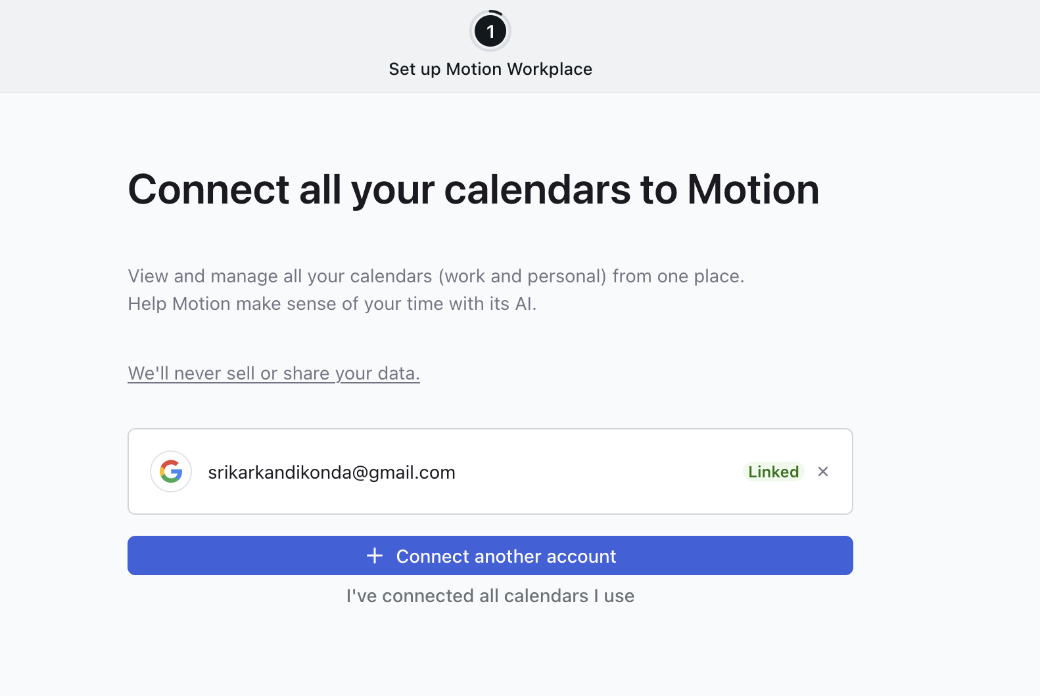
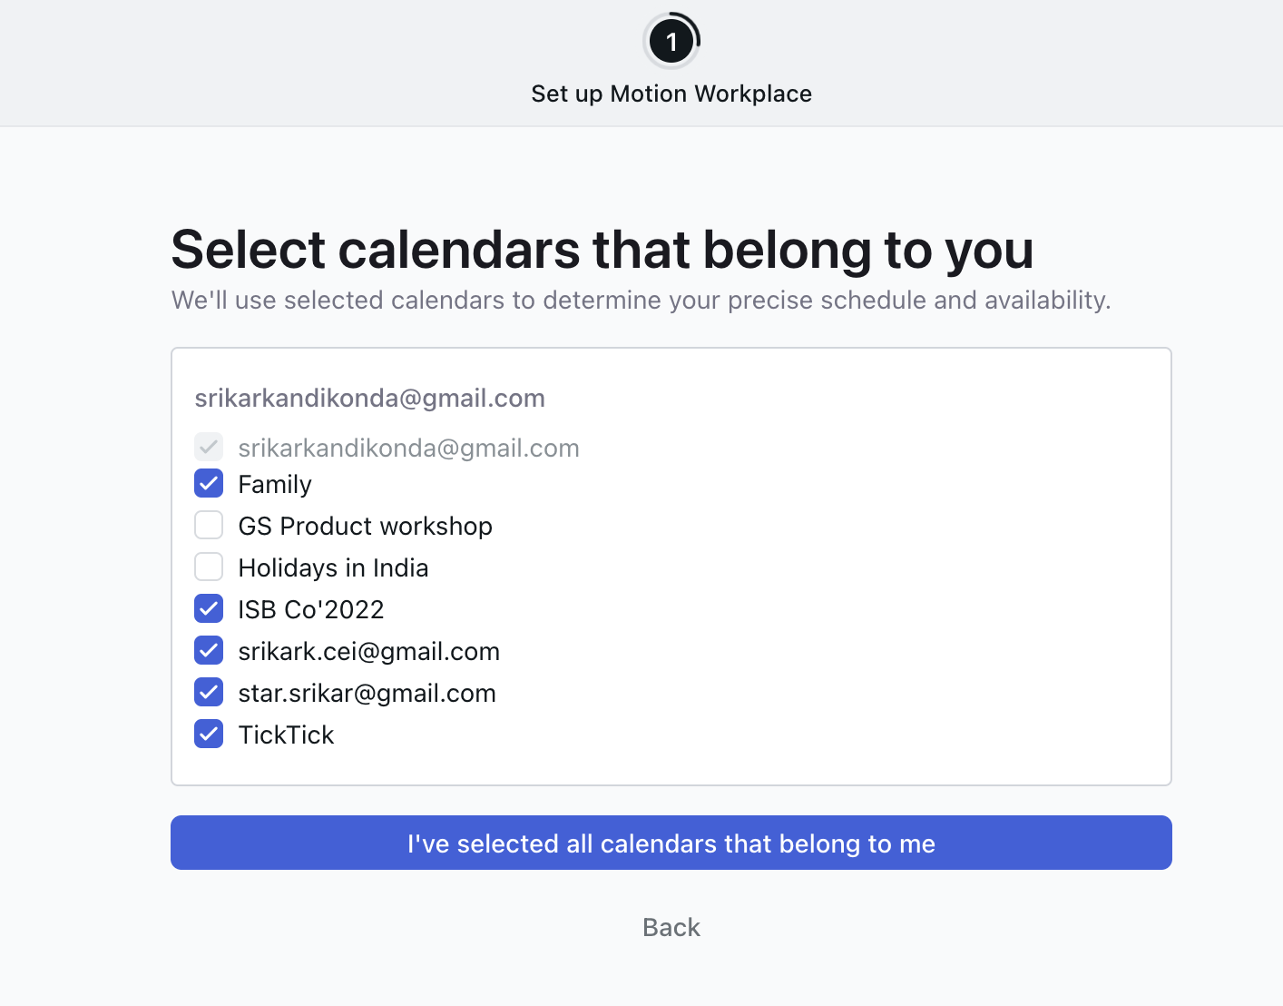
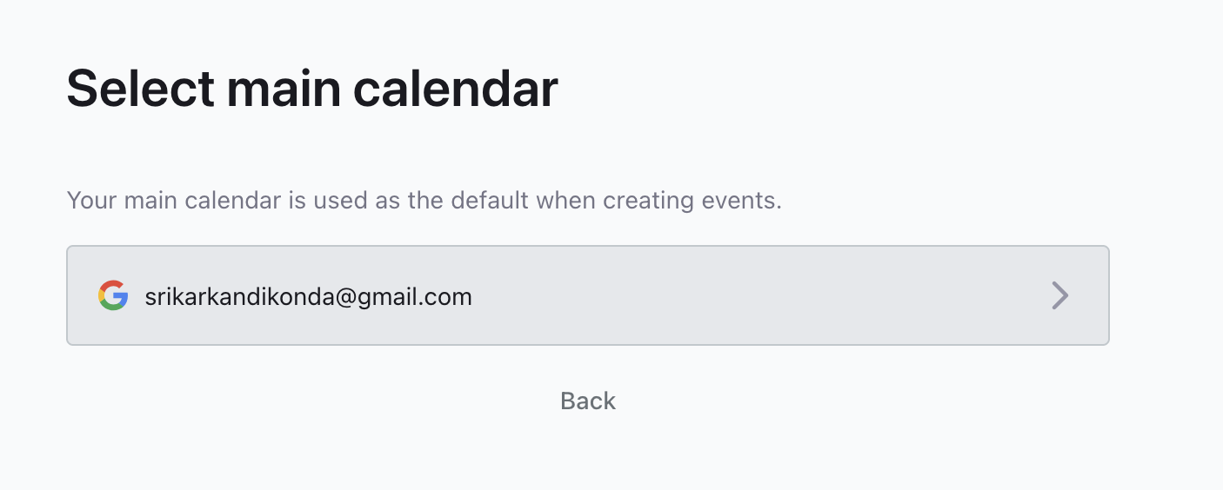
1
3
2

Slide 8
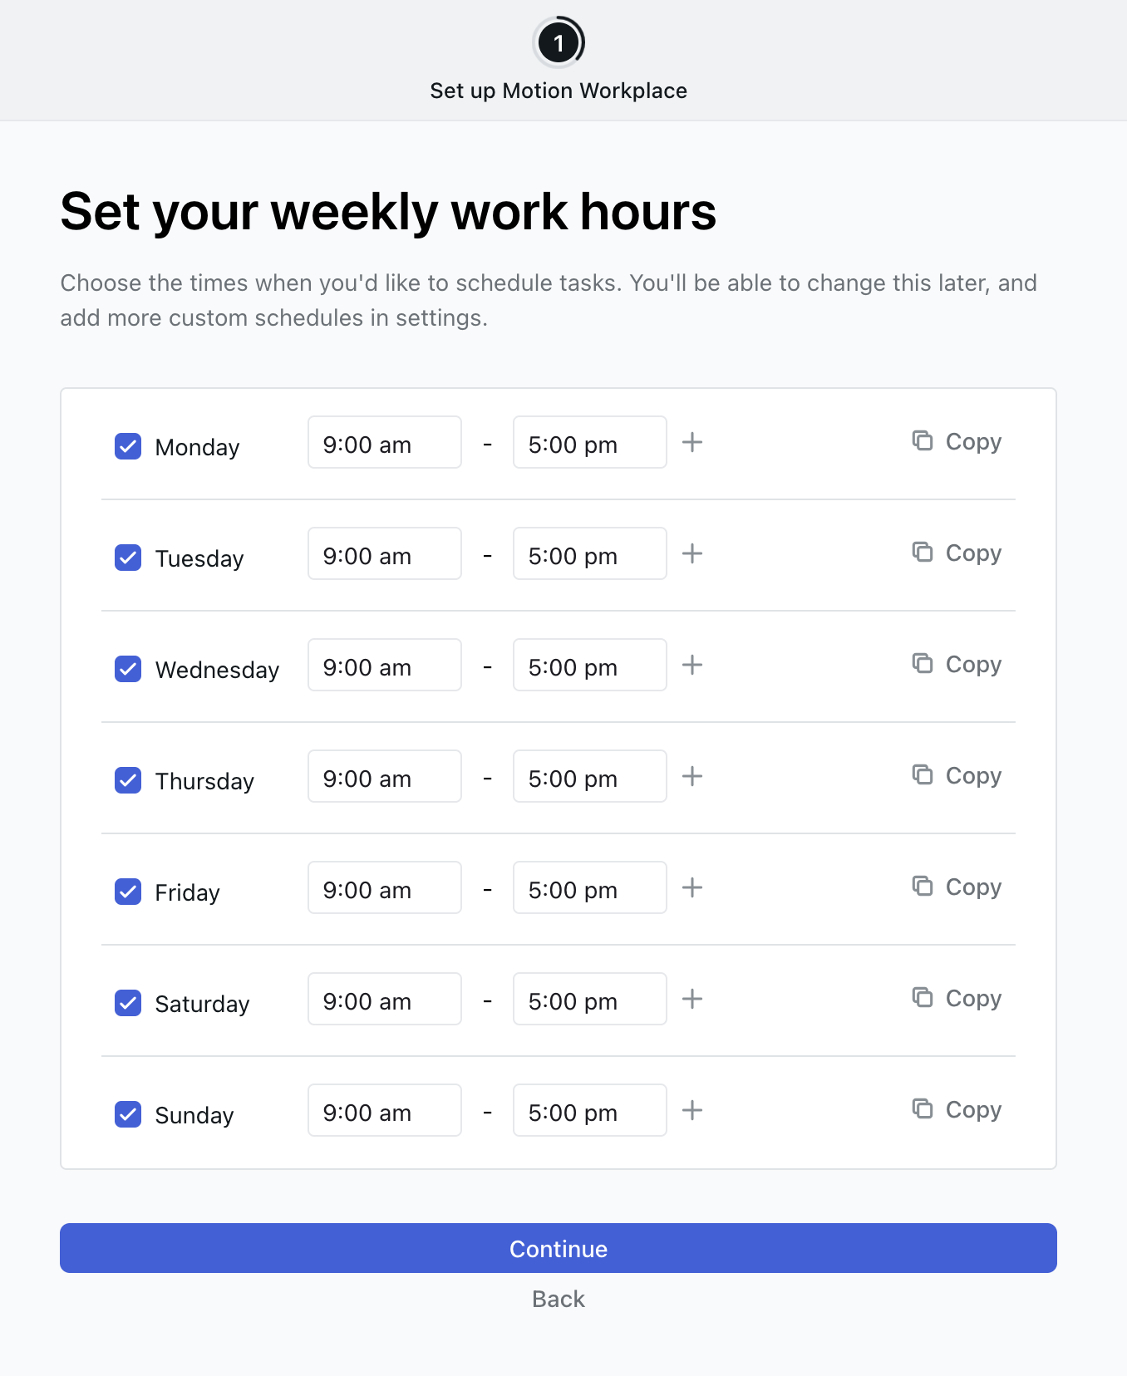
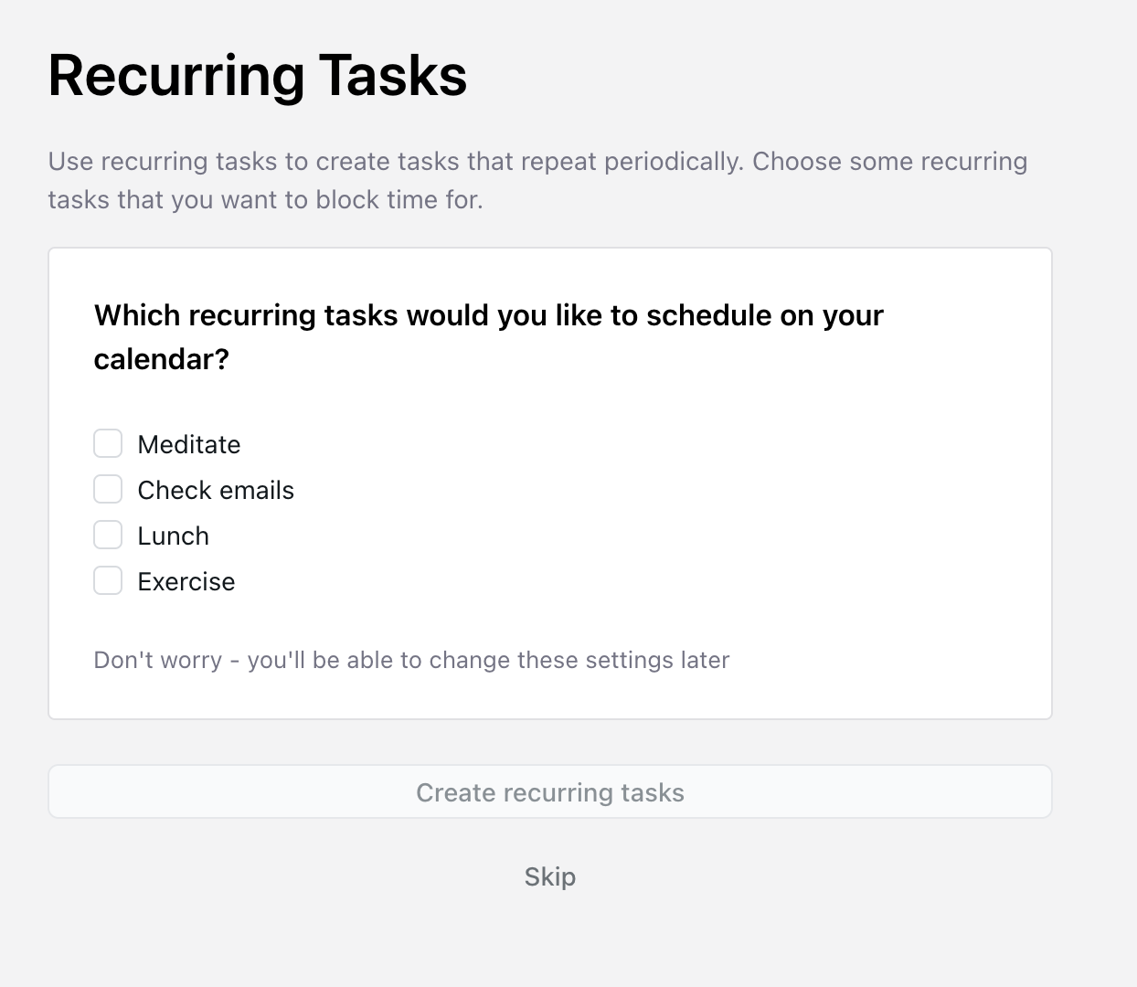
4
5

Slide 9
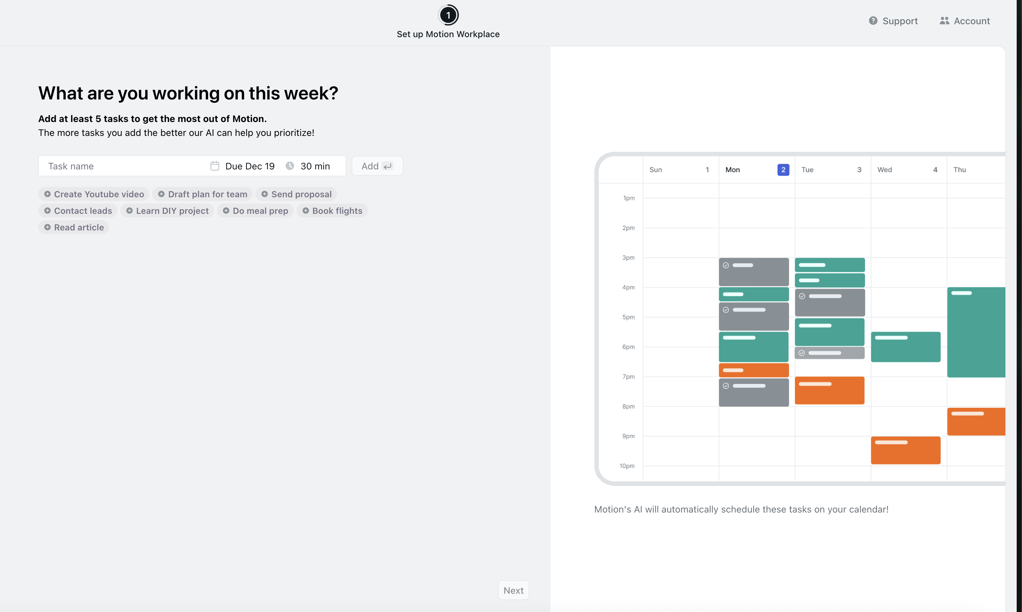
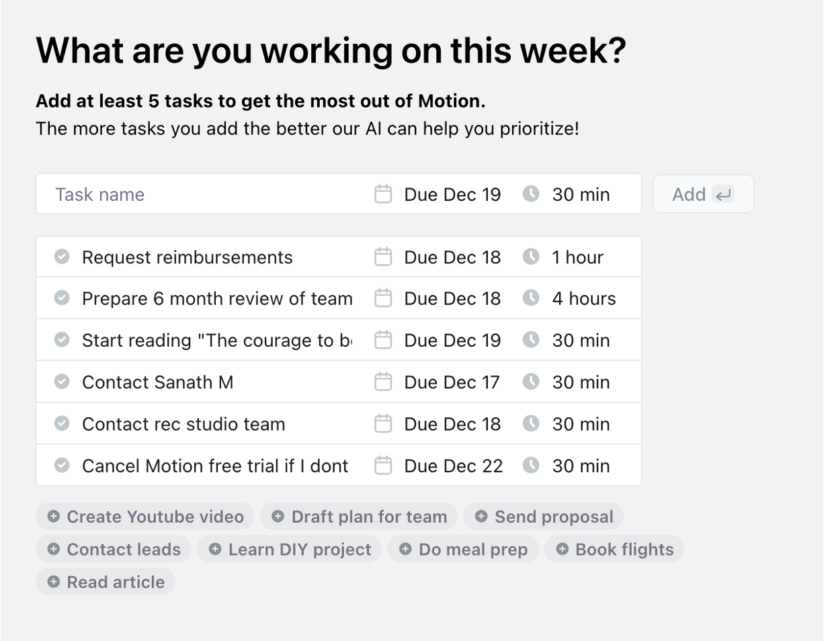
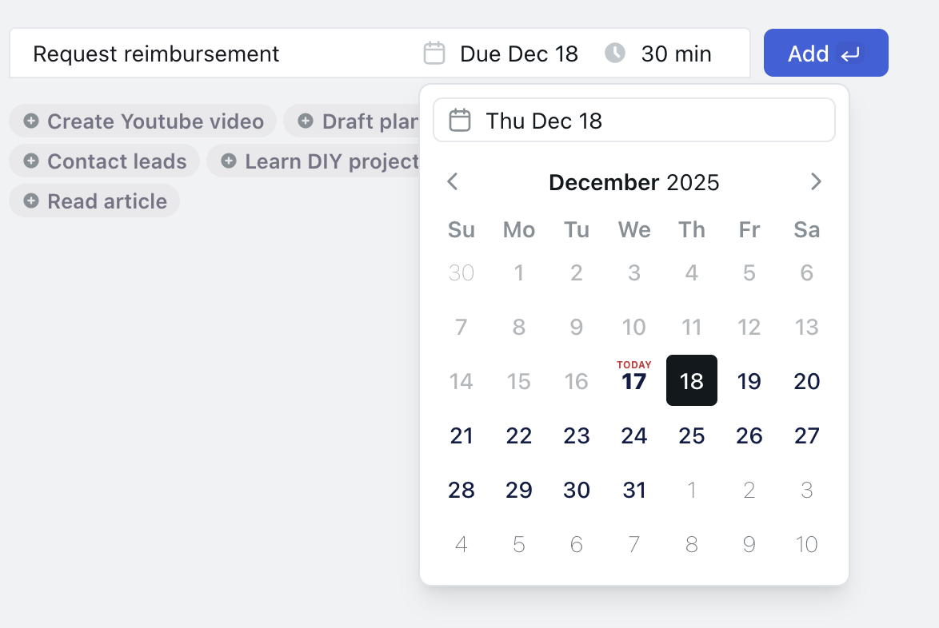
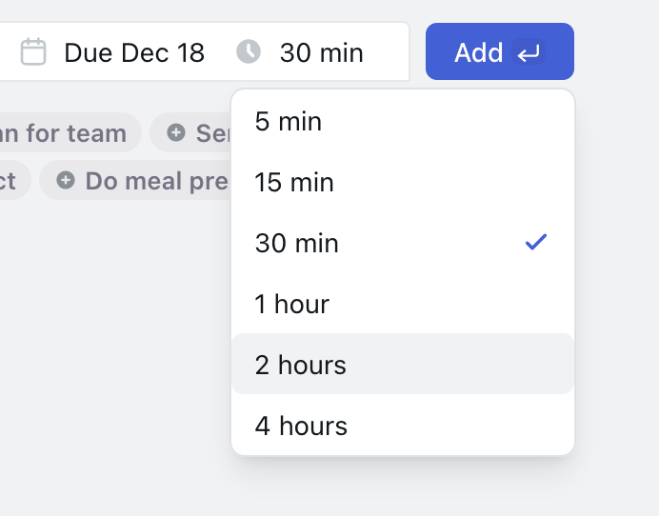
6c – Added some real tasks
6
6a
6b

Slide 10
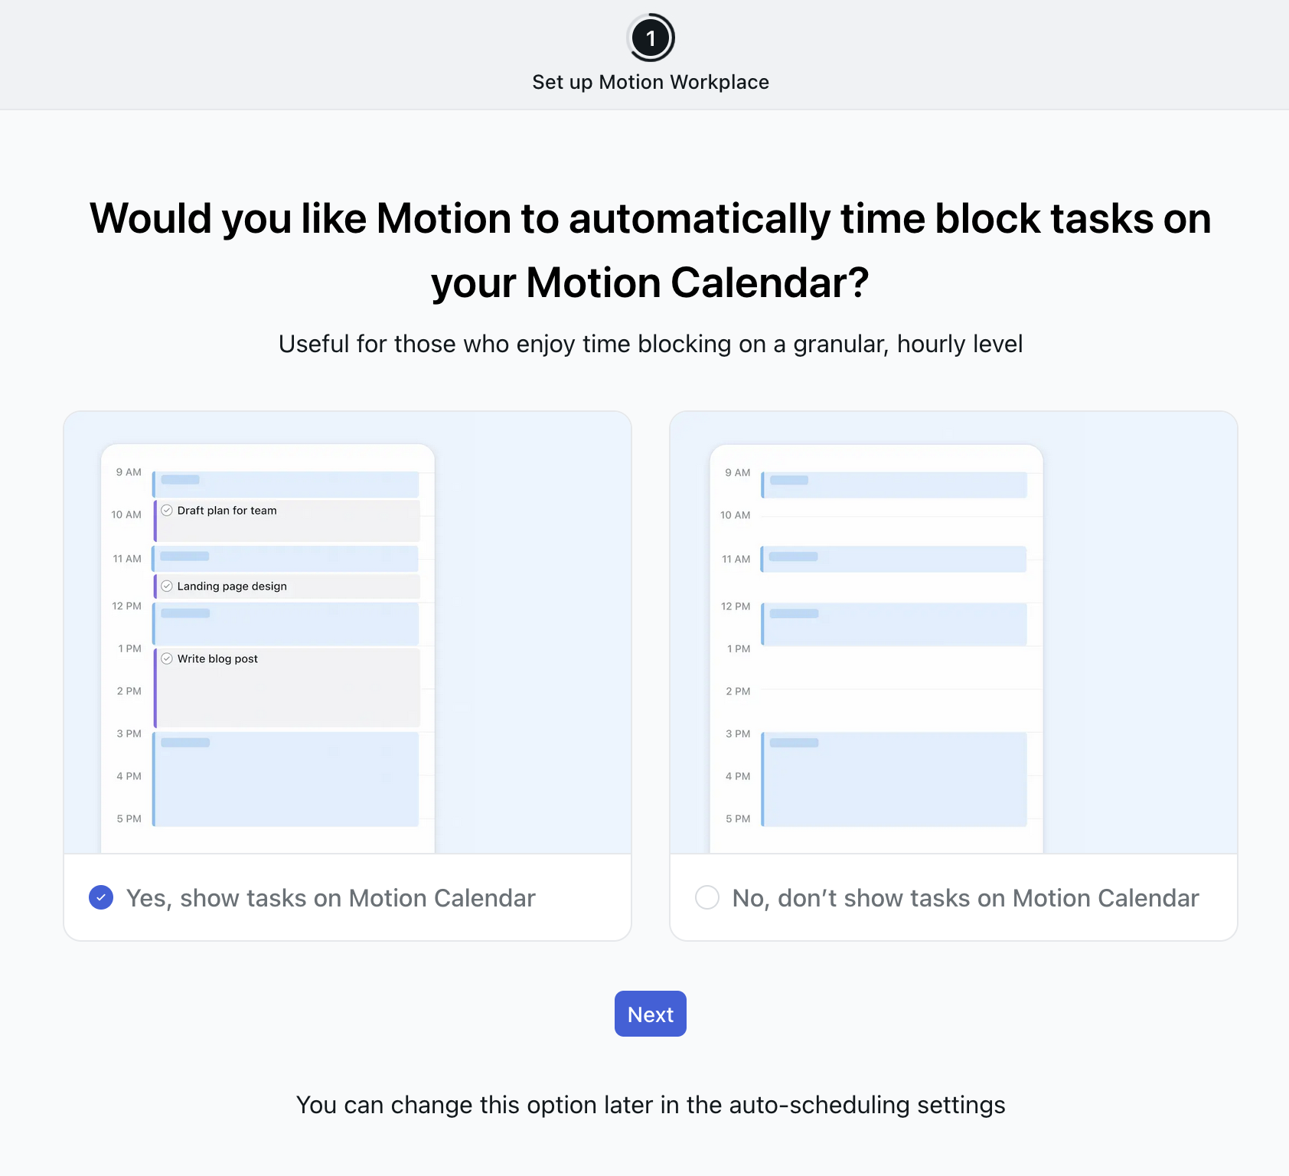
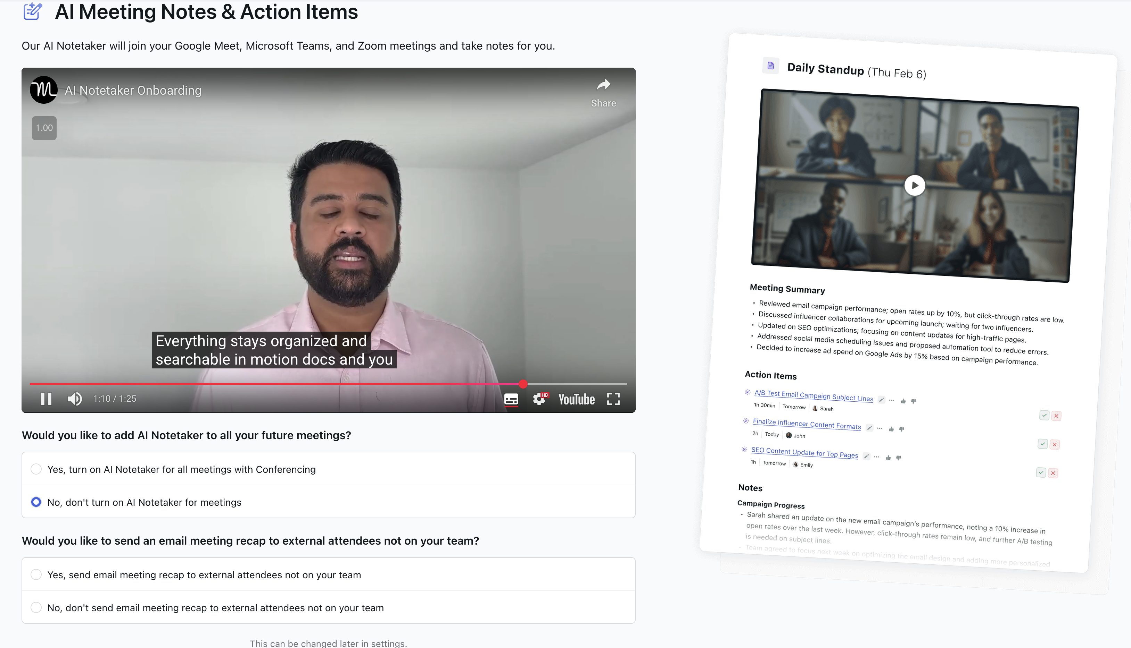
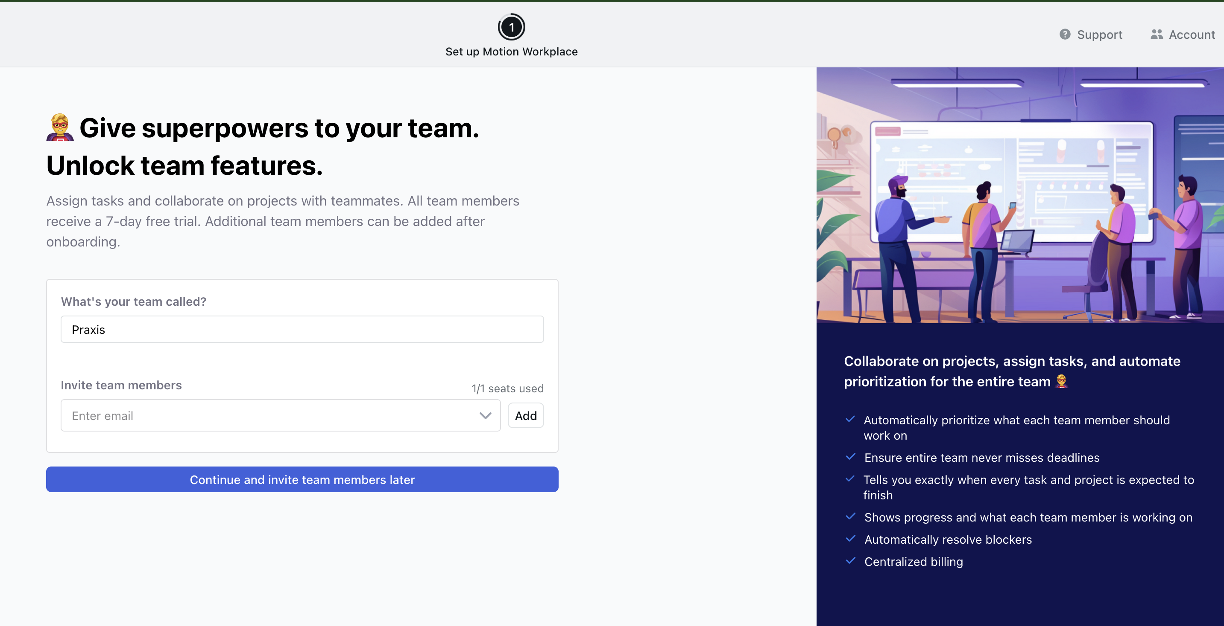
8
https://www.youtube.com/watch?v=URqhp6UkCwA
7
9
10 – Last page was select theme

Slide 11
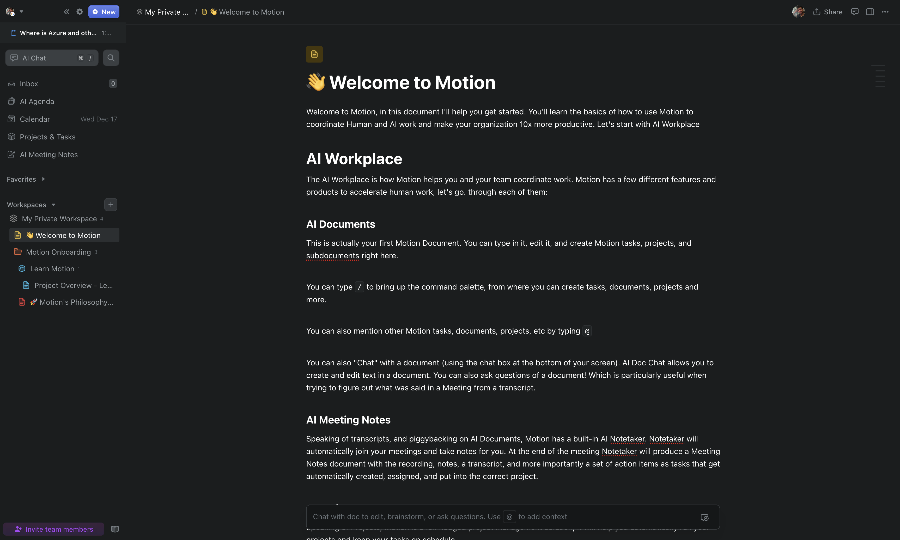
Landing page
Welcome to Motion, in this document I'll help you get started. You'll learn the basics of how to use Motion to coordinate Human and AI work and make your organization 10x more productive. Let's start with AI Workplace
AI Workplace
The AI Workplace is how Motion helps you and your team coordinate work. Motion has a few different features and products to accelerate human work, let's go. through each of them:
AI Documents
This is actually your first Motion Document. You can type in it, edit it, and create Motion tasks, projects, and subdocuments right here.
You can type / to bring up the command palette, from where you can create tasks, documents, projects and more.
You can also mention other Motion tasks, documents, projects, etc by typing @
You can also "Chat" with a document (using the chat box at the bottom of your screen). AI Doc Chat allows you to create and edit text in a document. You can also ask questions of a document! Which is particularly useful when trying to figure out what was said in a Meeting from a transcript.
AI Meeting Notes
Speaking of transcripts, and piggybacking on AI Documents, Motion has a built-in AI Notetaker. Notetaker will automatically join your meetings and take notes for you. At the end of the meeting Notetaker will produce a Meeting Notes document with the recording, notes, a transcript, and more importantly a set of action items as tasks that get automatically created, assigned, and put into the correct project.
AI Project Management
Speaking of Projects, Motion is a full fledged project management solution, it will help you automatically run your projects and keep your tasks on schedule
Create Your First Tasks
Let’s start by adding a few tasks for this week to get things moving.
Use the /task command to create your next three important tasks. Go ahead, give it a try below:
As you add tasks, Motion will start organizing them into your schedule for you.
Create your first project using Project Workflow Templates (PWTs)
Now that you have a few tasks, let’s create a project. Projects help you group related tasks together and track progress more efficiently.
Click the New button in the top left corner of your screen and select New Project.
Choose Create Project Template with AI to generate a Project Workflow Template. This helps standardize your processes and saves you time. By creating a Project Workflow Template in Motion, you can be confident that every project will follow your standard operating procedures and run automatically.
Next, describe your project. Motion will turn that description into a standard operating procedure (SOP) and save it as a reusable template.
You can also use the /project command to create a new project directly in your document.
Now that you’ve created your first project, I recommend watching this video on Motion’s project management philosophy. It will help you align your team on how to use Motion to improve efficiency, increase predictability, and reduce micromanagement.
AI Calendar and AI Agenda
Combining all of the above Motion does two things for you:
It generates a daily AI Agenda with your tasks for the day. This is just like any other Motion document, so you can create new tasks inline, rearrange them, take notes, etc
It time-block tasks on your calendar: Motion gives you the option to time block tasks on your calendar (if that's something you are into). Making it easy to follow Motion's optimized schedule to meet all your deadlines.
With Motion's AI Workplace you are now using the word's most advanced productivity platform. Thank you for using Motion!
Luis,
Head of Product @Motion

Slide 12
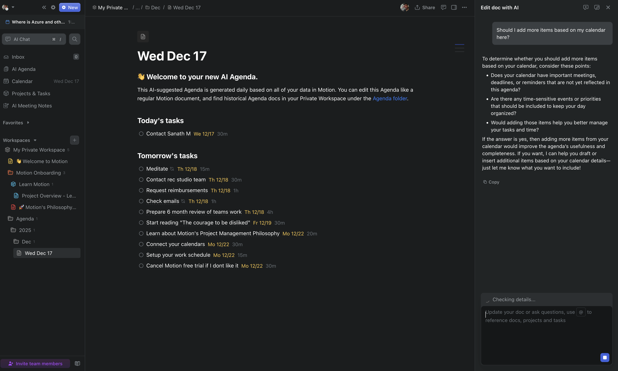
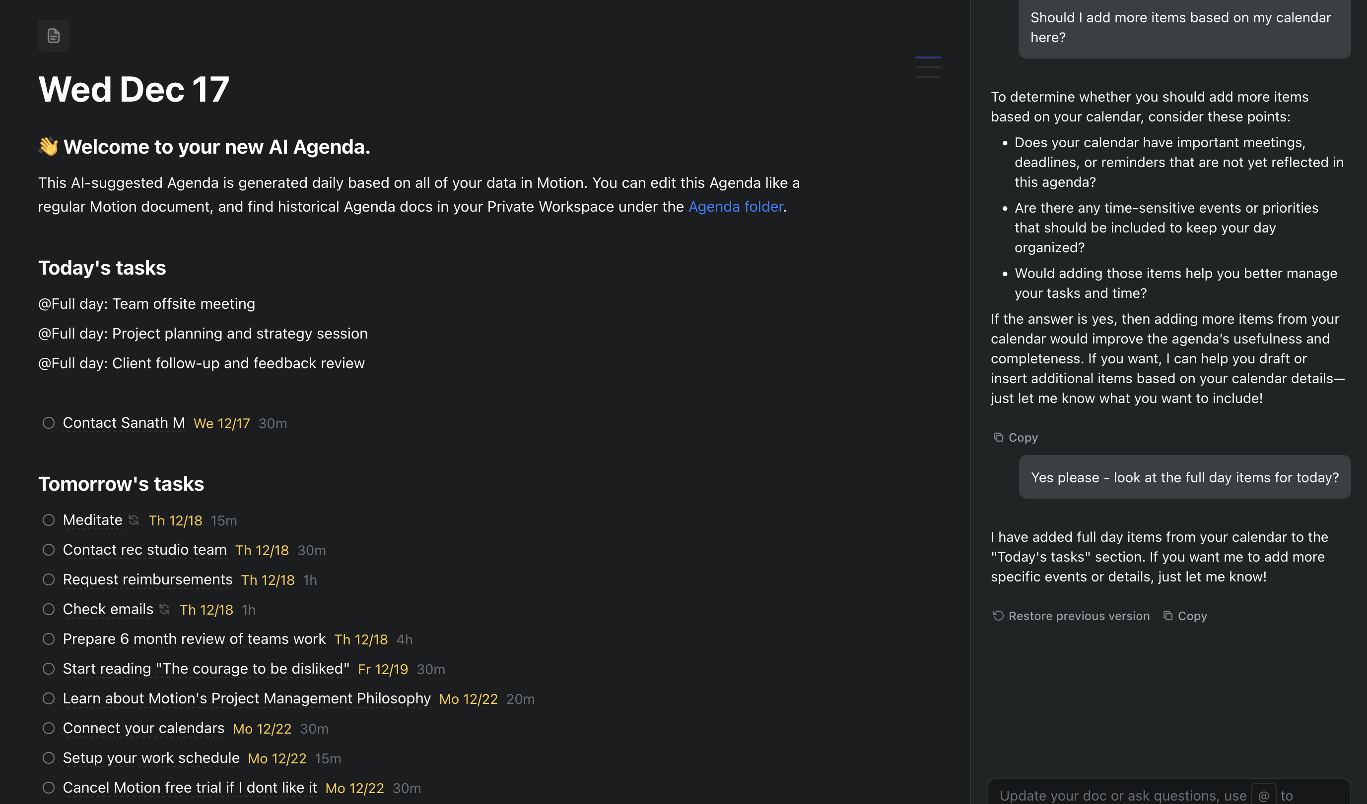
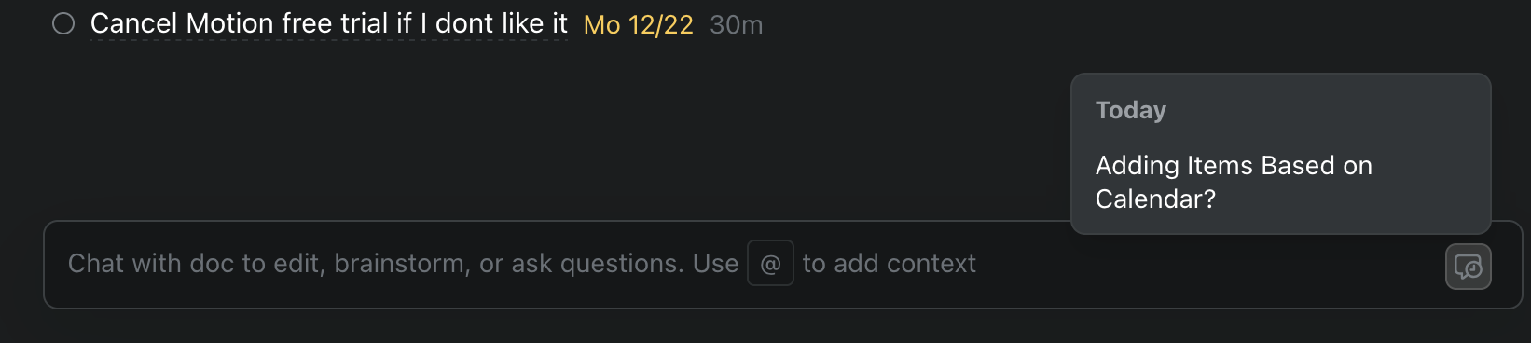

Slide 13
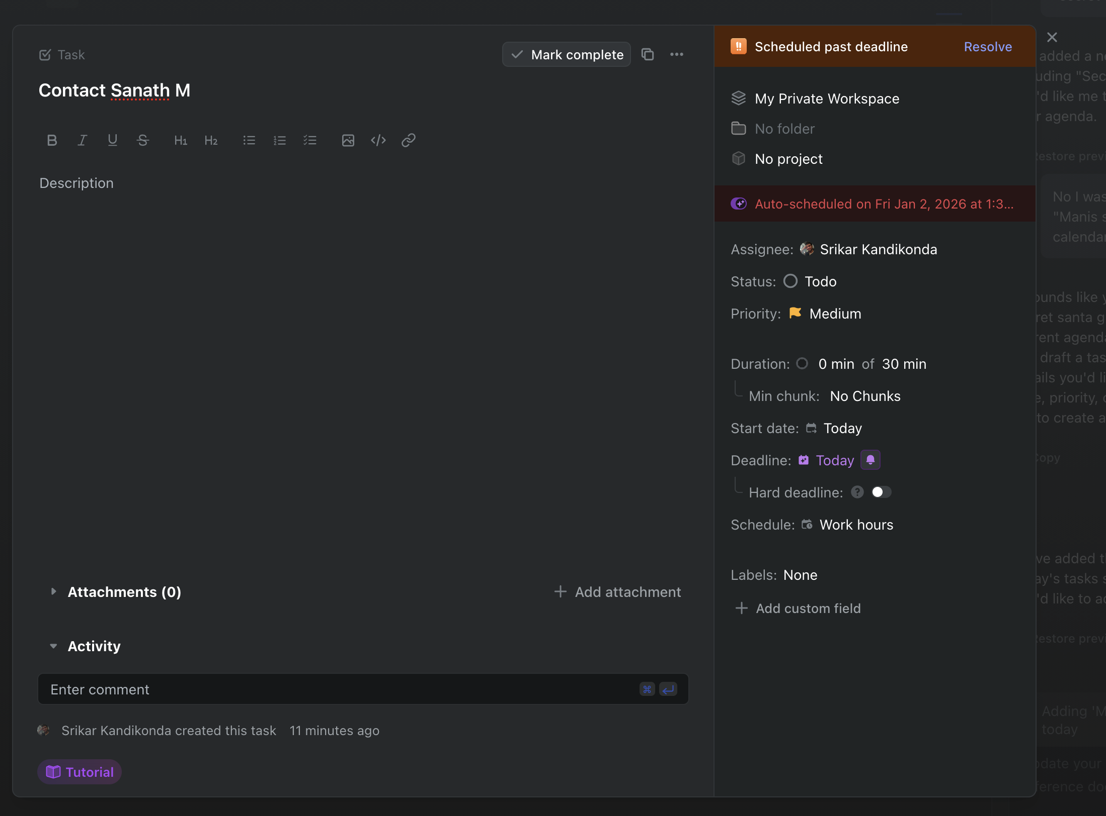
Task view

